Slide 2
Propelling your Career with Pluralsight and Microsoft Azure
Michael Bender
Author Evangelist, Pluralsight
@MichaelBender
Notes:
If you are like many people you may not be sure where to get started learning 'The Cloud' and Microsoft Azure. Unlike On-Prem, there are so many ‘shiny things’ that are constantly changing, it’s really heard to figure out where to start. If that is the case, don’t worry; you are not alone, and you’ve come to the right place. I'm Michael Bender, an Author Evangelist at Pluralsight, and today you'll learn where and how to start (or continue) your Cloud career journey. Everyone will leave with ideas to get learning and propel your career forward in The Cloud.

Slide 3
Propelling your Career with Pluralsight and Microsoft Azure
Michael Bender
Author Evangelist, Pluralsight
@MichaelBender

Slide 4
Notes:
I’m not going to waste any of your time here explaining why you need to learn how to work in the cloud and Microsoft Azure. You’re hear because you know that the roles in IT are changing, and you need to change with them.
For years, we saw roles in IT that were silo'd. Maybe you were an exchange admin, managed networking, or developed apps. It was common-place to have that area of focus and go deep in that particular technology. And people were good at that, and succesful. When I start in IT, it was the late 90’s and we were knee deep in the PC revolution. I
That changes with the cloud. As many of the 'hands-on' low-level tasks are automated, we find that in order to do our job we have to wear many hats, and the area we have to cover has become more broad across the spectrum .
Sure, you might be able to get by just doing Exchange Online only, but chances are the organization that needs Exchange also needs teams, OneDrive, SharePoint, and many other things from the O365 suite of products. And they are going to go to the person that has knowledge across the broader area, even if they are not as deep in a particular area.
That is where the focus on job roles comes in.
d so focusing on a particular technology won't work.
Today, organizations are looking for job roles that span technology stacks. For Instance, many companies looking for an Azure Administrator need someone who understands virtual machines, storage, networking along with platform as a service options like containers, web apps, and software as a service components like Azure AD. Plus, they probably want some experience with coding like PowerShell, Python, or other languages. Not to mention
As you are looking towards the future and where you want to take your career, you need to widen the lense to see all of the skills you'll need to succeed.

Slide 5
Popular Job Roles
Administrator
Developer
Solutions Architect
Security Engineer

Slide 6
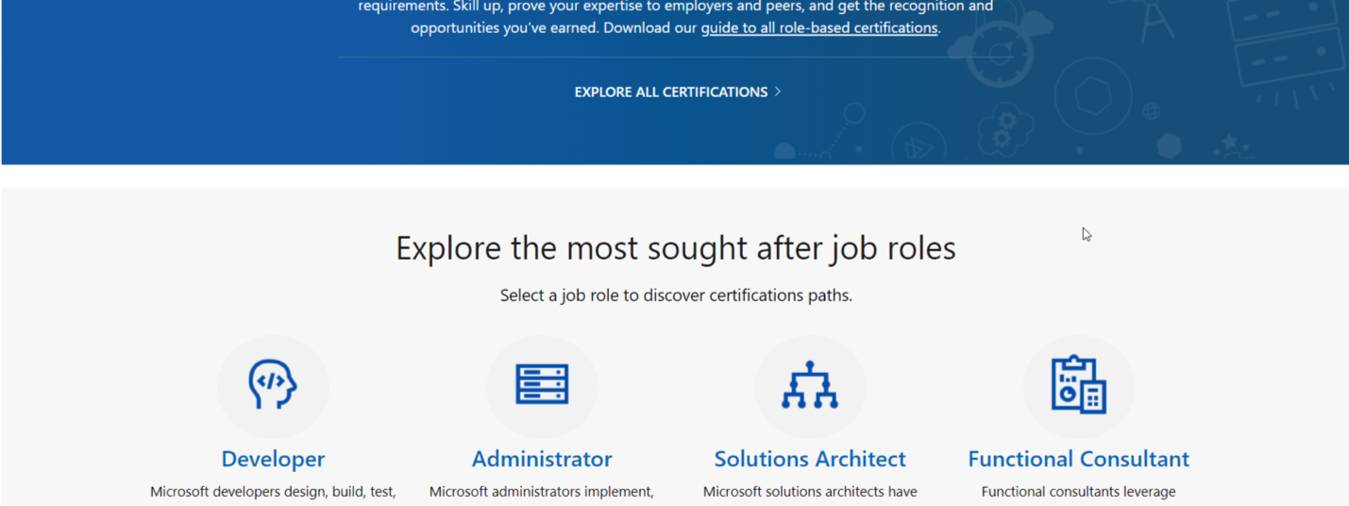
Microsoft Role-Based Certifications
Notes:
Fortunately, you have some help in the Azure world.
With Microsoft's updated certifications, all are role based and designed around in-demand job roles.
Riff on roles, cover top 4
Dive into Administrators
Slide 9 in PDF

Slide 7
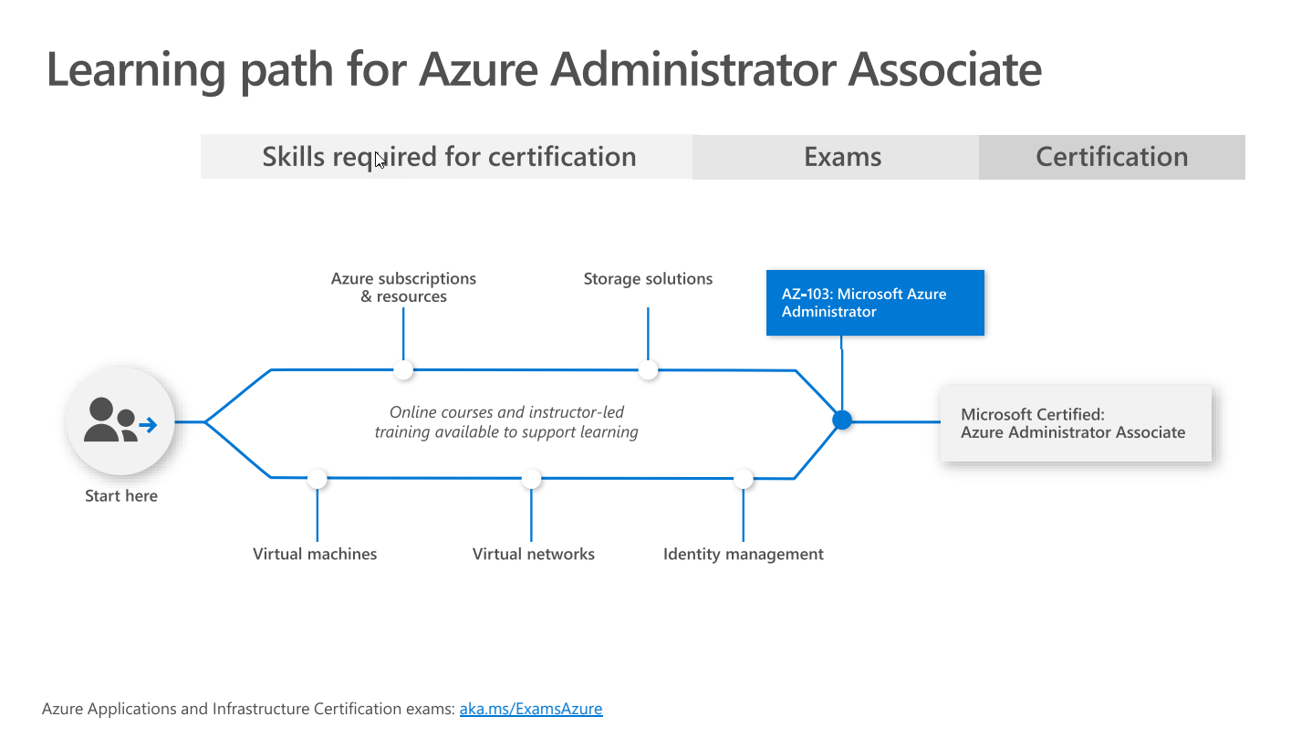
Notes:
Ref: https://query.prod.cms.rt.microsoft.com/cms/api/am/binary/RWtQJJ

Slide 8
Pluralsight and RoleIQ
Notes:
We've worked directly with Microsoft to build out courses design to meet the needs of sought-after job roles including:
List of 5
And to assist you with the learning, let me introduce you to Role IQ
Role IQ is an assessment platform that quantifies your technical proficiency in a specific role. By measuring your knowledge in relevant skills, role IQ tells you what level you’re at and shows you what skills you need to work on to build your expertise.

Slide 9
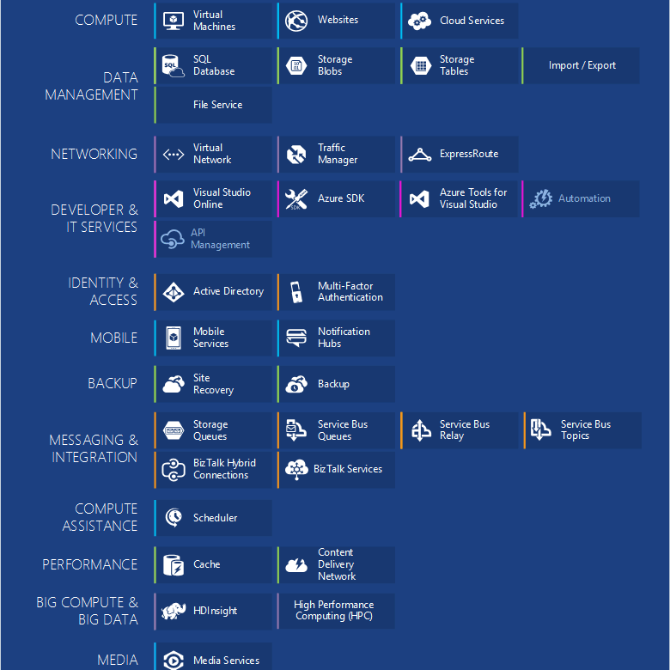

Slide 10
How To Use RoleIQ
Assess It
Skill Up
Rock Your Role
Notes:
To use Role IQ, you go through 4 steps
Slide
See Where You Stand
Get Your Role IQ
Improve Your Skill
Rock your Role
First, you See where you stand by completing assessments related to the job role you've chosen.
After completing all the assessments for the job role, you'll receive your Role IQ. This shows what level you are at on the role's learning path based on your current technical proficiency.
Now it's time for learning. Based on your Role IQ score, you'll be provided learning opportunities to fill in skills gaps and get to the next level.
And like any learning experience, you need to evaluate to see how you've grown. After comp

Slide 11
Benefits from a Learner Standpoint

Slide 12
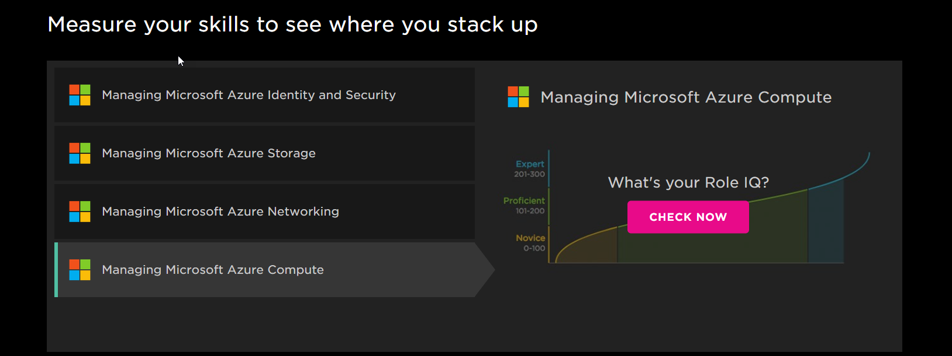
Role IQ in Action with Azure Administrator Role
Notes:
Let's see Role IQ in action for the Azure Administrator job role.
Microsoft Azure Administrator
Managing Microsoft Azure Identity and Security
Managing Microsoft Azure Storage
Managing Microsoft Azure Networking
Managing Microsoft Azure Compute
Managing Microsoft Azure App Services ²
Monitoring Microsoft Azure ²

Slide 13
Getting Started with RoleIQ
http://bit.ly/azure-ps
Notes:
How to use data from Role IQ 3-4m
Azure: https://www.pluralsight.com/partners/microsoft/azure
Azure Administrator
Walk through role skill areas
Show Profile area

Slide 14
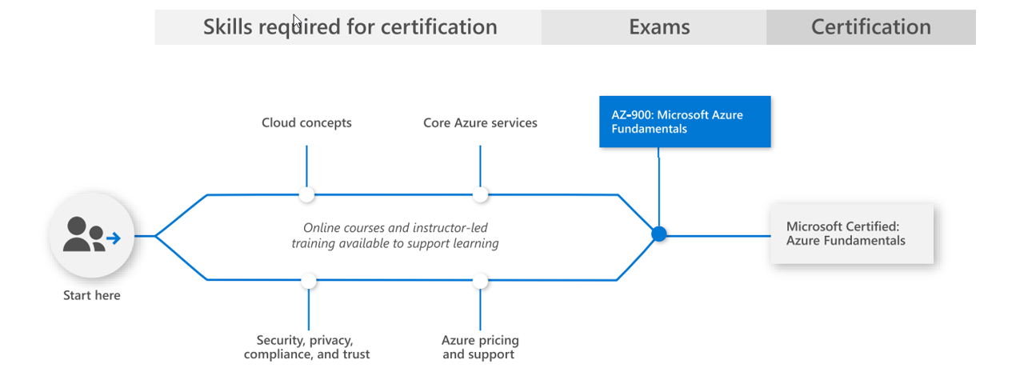
Azure Fundamentals Learning Path
Notes:
Now let's look at how you would begin down the path for specific certifications
First let's take a look at the Azure Fundamentals exam and using Microsoft learn
Link?

Slide 15
How to study
Resources

Slide 16
Microsoft Docs
What it is
How to use it

Slide 17
Getting Started with Microsoft Learn and Docs.com
Notes:
Microsoft Learn -2-3m
What it is
Training Available
How it works
Choices
Learning Path
Search for role > solution Architect
Choose Core Cloud Services
Show Sandbox

Slide 19
Moving Forward
Choose a path
Get some Knowledge
PS
Docs
Get Hands On
Prove Your Skills
Optional
Take the cert

Slide 21
Presentation title
Speaker name
Title

Slide 22
Presentation title
Speaker name
Title

Slide 23
Presentation title
Speaker name
Title

Slide 24
Presentation title
Speaker name
Title

Slide 25
Text layout (without bullet points)
Main topic: Segoe UI, size 28pt
Segoe UI, size 20pt for second level
Segoe UI, size 16pt for third level

Slide 26
Text layout with bulleted text
Main topic: Segoe UI, size 28pt
Segoe UI, size 20pt for second level
Segoe UI, size 16pt for third level

Slide 27
Example with longer headline text wrapping to a second line
When the headline text is 2 lines, move this text block down to align to the lower blue guide
If you don’t see guidelines, click on the View menu, and then check the box in front of “Guides”
Use a “soft return” Shift + Enter to wrap text without adding extra line spacing

Slide 28
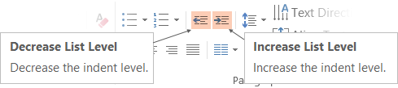
Adjusting list levels
Main topic: Segoe UI, size 28pt
Segoe UI, size 20pt for second level
Segoe UI, size 16pt for third level
Use the “Decrease List Level” and “Increase List Level” tools on the Home menu to change text levels.
Try this:
Place your cursor in the line of text that says “Segoe UI, size 20pt for second level”
Next click the Home tab, and then on the “Decrease List level” tool. Notice how the line moves up one level.
Now try placing your cursor in one of the top “Main topic…” line of text. Click the “Increase List Level” tool and see how the text is pushed in one level.
Use these 2 tools to adjust your text levels as you work

Slide 29
Bullet points layout with subtitle Set the subtitle to 20pt in the same text block, with character spacing Normal
Move the text block down vertically to align to lower guide
If you don’t see guidelines, click on the View menu, and then check the box in front of “Guides”
Hyperlink style: www.microsoft.com

Slide 30
Title square photo layout
Smaller text

Slide 31
Square photo layout

Slide 32
Slide palette info
The PowerPoint palette for this template has been built for you and is shown below.
Avoid using too many colors in your presentation.
PowerPoint Theme Accent colors
Accent 1
Accent 2
Accent 3
Accent 4
Accent 5
Accent 6
Use Accent 1 as the main accent color.
Use Accent 2 and Accent 3 only when additional colors are needed.
Use Accents 4-6 sparingly

Slide 33
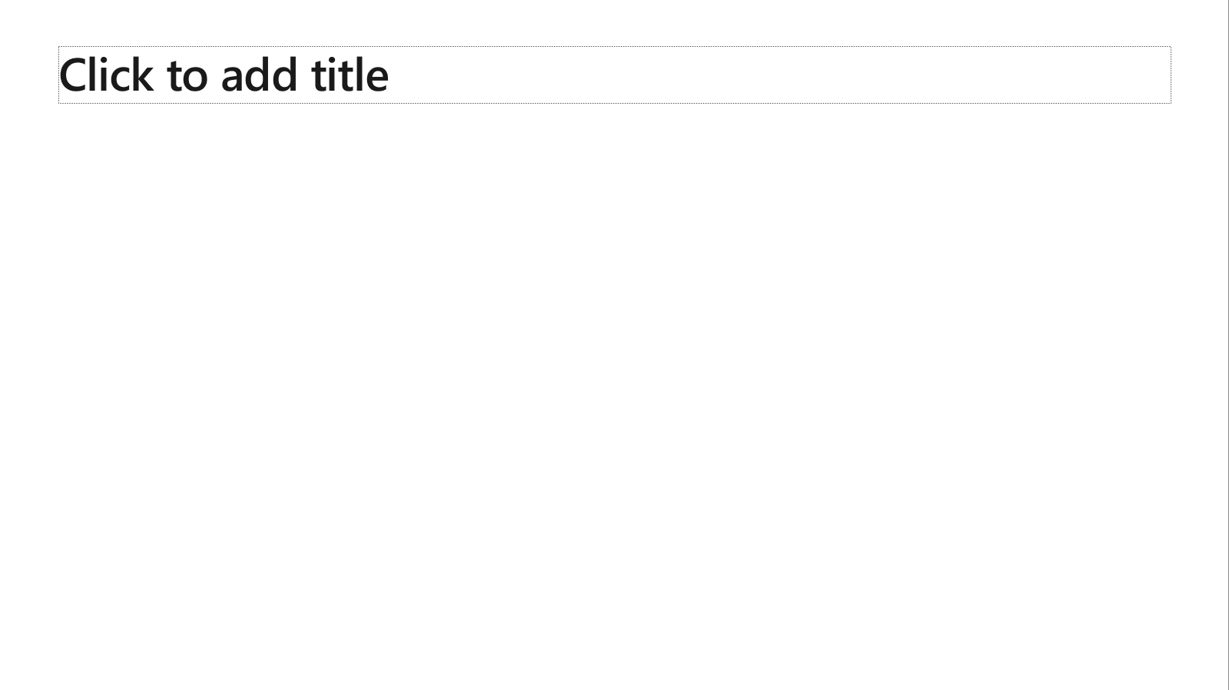
Ensure slide content is accessible
Take the following steps to create accessible content that everyone can consume effectively.
Contrast
Use high contrast colors for maximum readability
The recommended contrast ratio is at least 4.5:1
Shape and color
Use different shapes with a legend to indicate statuses to accommodate for color blindness
Example:
Alt text
Alt text helps people with screen readers understand the content of slides
You should create alternative text for shapes, pictures, charts, tables, SmartArt graphics, or other objects
Here’s how:
Right click on item
Select Edit Alt Text
Enter a Description
If an object is meant to add visual styling and doesn’t contain meaning (e.g. stylistic borders), do not add alt text and instead check Mark as decorative
Slide layouts
Using a built-in slide layout that matches your content ensures a hierarchical reading order of text blocks
Example:
If a new slide will have a title, rather than starting with a blank layout and adding a text block for the title, choose one of the built-in layouts with a title placeholder
Reading order
Screen readers describe content on the screen in the order it was created
To ensure your content is read back in the order you prefer, arrange your objects in the Selection Pane appropriately. Objects on the bottom of the selection pane are read first
Here’s how:
Click the Home tab
In the Drawing group, select the Arrange drop-down menu
Click Selection Pane…
Text
Text
Text
Subject 1
Subject 2
Subject 3
Color Contrast Analyzer
Download this tool to determine the legibility of text and the contrast of visual elements
Download
C1
C2
C3
Additional tips
Be sure to run the Accessibility Checker! Go to File click the Check for Issues drop down menu click Check Accessibility
Videos need to be accessible: If your presentation includes a video, ensure it is captioned and audio described (if appropriate)
Visit the Office Accessibility Center to learn more about accessibility in PowerPoint

Slide 34
Brand and accent colors accessibility
Type and background combinations must meet a minimum 4.5:1 contrast ratio to help ensure people of all abilities can access and understand our communications.
Pick colors carefully and avoid relying on color alone to convey information. Always provide text or other graphical cues to guide customers to our message.
Examples demonstrate correct color use for on-screen applications.
Get the Color Contrast Analyzer
Get more information on accessibility
Get the Microsoft color guidelines PDF
Dark Orange
Rich Black
R255 G147 B73 Hex #FF9349
Dark Yellow
Rich Black
R254 G240 B0 Hex #FEF000
Dark Green
Rich Black
R155 G240 B11 Hex #9BF00B
Dark Teal
Rich Black
R48 G229 B208 Hex #30E5D0
Dark Blue
Rich Black
R80 G230 B255 Hex #50E6FF
Dark Purple
Rich Black
R213 G157 B255 Hex #D59DFF
White
Rich Black
R216 G59 B1
Hex #D83B01
Rich Black
R255 G185 B0
Hex #FFB900
White
R16 G124 B16
Hex #107C10
White
Rich Black
R0 G133 B117
Hex #008575
White
Rich Black
R0 G120 B212
Hex #0078D4
White
Rich Black
R134 G97 B197
Hex #8661C5
Light Orange
White
R107 G41 B41 Hex #6B2929
Light Yellow
White
R106 G75 B22 Hex #6A4B16
Light Green White
R5 G75 B22 Hex #054B16
Light Teal
White
R39 G75 B71 Hex #274B47
Light Blue
White
R36 G58 B94 Hex #243A5E
Light Purple
White
R59 G46 B88 Hex #3B2E58
White
R255 G255 B255
Hex #FFFFFF
Orange
Dark Orange
Dark Yellow
Green
Dark Green
Teal
Dark Teal
Blue
Dark Blue
Purple
Dark Purple
Rich Black
R0 G0 B0
Hex #000000
White
Light Orange
Orange
White
Light Yellow
Yellow
White
Light Green
White
Light Teal
Teal
White
Light Blue
Blue
White
Light Purple
Purple
Extra Light Gray
R242 G242 B242
Hex #F2F2F2
Light Gray
R230 G230 B230
Hex #E6E6E6
Gray
R210 G210 B210
Hex #D2D2D2
Mid Gray
R115 G115 B115
Hex #737373
Dark Gray
R80 G80 B80
Hex #505050
Extra Dark Gray
R47 G47 B47
Hex #2F2F2F

Slide 35





PowerPoint Design Ideas
Get suggestions for slides
PowerPoint Designer can create suggestions for your slide content.
To access Design Ideas, click the “Design” tab in the Ribbon and then “Design Ideas” on the right.
Designer will also trigger when you insert an image.

Slide 36

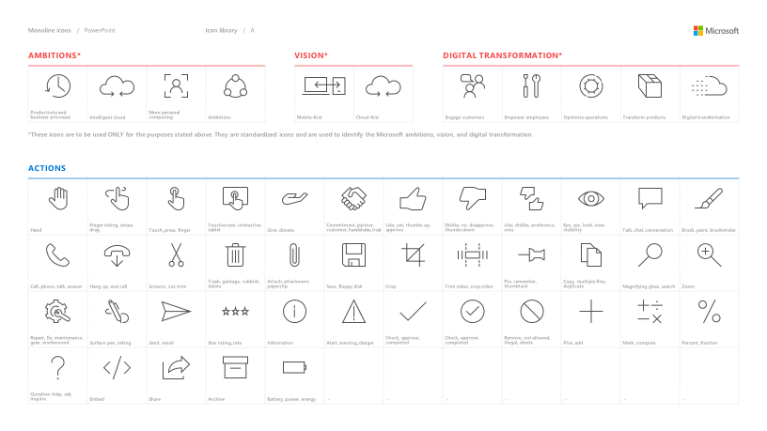
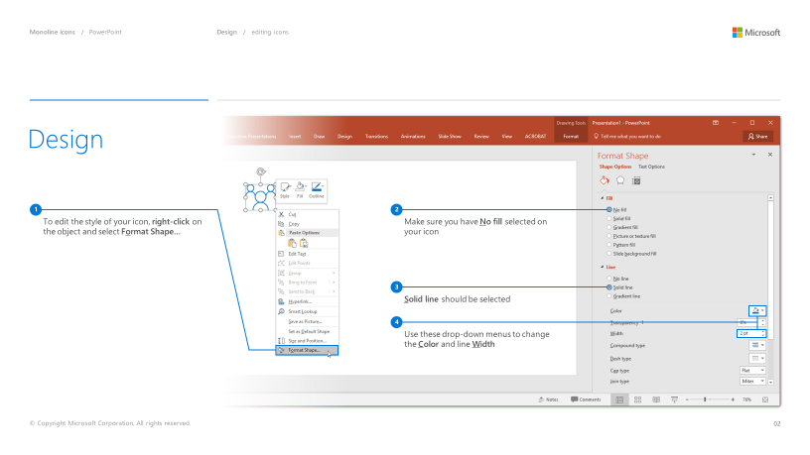
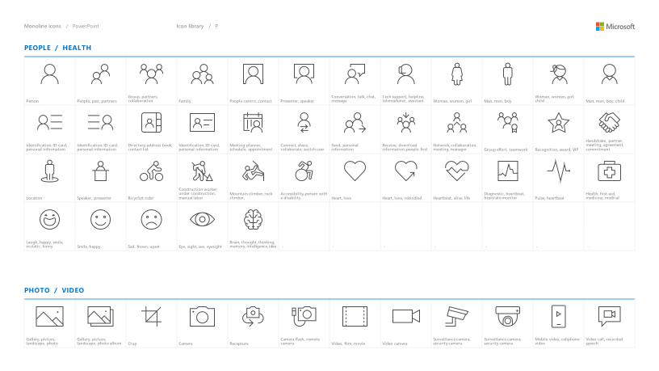
Microsoft monoline icons
Looking for icon resources?
The Monoline icon library for PowerPoint is a slide deck that provides a library of icons for use in PowerPoint presentations.
The Monoline icon style guide for PowerPoint is a pdf with additional guidelines.
Download both from Brand Central.

Slide 37
Demo
Speaker name

Slide 38
Section title

Slide 39
Software code slide
This slide layout uses Consolas, a monotype font which is ideal for showing software code.

Slide 40
Notes (hidden)
Some speakers at Microsoft like to use this slide for hidden “notes slides”.
Delete it if you don’t want to use it.
NEXT: <next slide title>

Slide 43
Presentation title
Speaker name
Title

Slide 44
Presentation title
Speaker name
Title

Slide 45
Presentation title
Speaker name
Title

Slide 46
Presentation title
Speaker name
Title

Slide 47
Text layout (without bullet points)
Main topic: Segoe UI, size 28pt
Segoe UI, size 20pt for second level
Segoe UI, size 16pt for third level

Slide 48
Text layout with bulleted text
Main topic: Segoe UI, size 28pt
Segoe UI, size 20pt for second level
Segoe UI, size 16pt for third level

Slide 49
Example with longer headline text wrapping to a second line
When the headline text is 2 lines, move this text block down to align to the lower blue guide
If you don’t see guidelines, click on the View menu, and then check the box in front of “Guides”
Use a “soft return” Shift + Enter to wrap text without adding extra line spacing

Slide 50
Adjusting list levels
Main topic: Segoe UI, size 28pt
Segoe UI, size 20pt for second level
Segoe UI, size 16pt for third level
Use the “Decrease List Level” and “Increase List Level” tools on the Home menu to change text levels.
Try this:
Place your cursor in the line of text that says “Segoe UI, size 20pt for second level”
Next click the Home tab, and then on the “Decrease List level” tool. Notice how the line moves up one level.
Now try placing your cursor in one of the top “Main topic…” line of text. Click the “Increase List Level” tool and see how the text is pushed in one level.
Use these 2 tools to adjust your text levels as you work

Slide 51
Bullet points layout with subtitle Set the subtitle to 20pt in the same text block, with character spacing Normal
Move the text block down vertically to align to lower guide
If you don’t see guidelines, click on the View menu, and then check the box in front of “Guides”
Hyperlink style: www.microsoft.com

Slide 52
Title square photo layout
Smaller text

Slide 53
Square photo layout

Slide 54
Slide palette info
The PowerPoint palette for this template has been built for you and is shown below.
Avoid using too many colors in your presentation.
PowerPoint Theme Accent colors
Accent 1
Accent 2
Accent 3
Accent 4
Accent 5
Accent 6
Use Accent 1 as the main accent color.
Use Accent 2 and Accent 3 only when additional colors are needed.
Use Accents 4-6 sparingly

Slide 55
Ensure slide content is accessible
Take the following steps to create accessible content that everyone can consume effectively.
Contrast
Use high contrast colors for maximum readability
The recommended contrast ratio is at least 4.5:1
Shape and color
Use different shapes with a legend to indicate statuses to accommodate for color blindness
Example:
Alt text
Alt text helps people with screen readers understand the content of slides
You should create alternative text for shapes, pictures, charts, tables, SmartArt graphics, or other objects
Here’s how:
Right click on item
Select Edit Alt Text
Enter a Description
If an object is meant to add visual styling and doesn’t contain meaning (e.g. stylistic borders), do not add alt text and instead check Mark as decorative
Slide layouts
Using a built-in slide layout that matches your content ensures a hierarchical reading order of text blocks
Example:
If a new slide will have a title, rather than starting with a blank layout and adding a text block for the title, choose one of the built-in layouts with a title placeholder
Reading order
Screen readers describe content on the screen in the order it was created
To ensure your content is read back in the order you prefer, arrange your objects in the Selection Pane appropriately. Objects on the bottom of the selection pane are read first
Here’s how:
Click the Home tab
In the Drawing group, select the Arrange drop-down menu
Click Selection Pane…
Text
Text
Text
Subject 1
Subject 2
Subject 3
Color Contrast Analyzer
Download this tool to determine the legibility of text and the contrast of visual elements
Download
C1
C2
C3
Additional tips
Be sure to run the Accessibility Checker! Go to File click the Check for Issues drop down menu click Check Accessibility
Videos need to be accessible: If your presentation includes a video, ensure it is captioned and audio described (if appropriate)
Visit the Office Accessibility Center to learn more about accessibility in PowerPoint

Slide 56
Brand and accent colors accessibility
Type and background combinations must meet a minimum 4.5:1 contrast ratio to help ensure people of all abilities can access and understand our communications.
Pick colors carefully and avoid relying on color alone to convey information. Always provide text or other graphical cues to guide customers to our message.
Examples demonstrate correct color use for on-screen applications.
Get the Color Contrast Analyzer
Get more information on accessibility
Get the Microsoft color guidelines PDF
Dark Orange
Rich Black
R255 G147 B73 Hex #FF9349
Dark Yellow
Rich Black
R254 G240 B0 Hex #FEF000
Dark Green
Rich Black
R155 G240 B11 Hex #9BF00B
Dark Teal
Rich Black
R48 G229 B208 Hex #30E5D0
Dark Blue
Rich Black
R80 G230 B255 Hex #50E6FF
Dark Purple
Rich Black
R213 G157 B255 Hex #D59DFF
White
Rich Black
R216 G59 B1
Hex #D83B01
Rich Black
R255 G185 B0
Hex #FFB900
White
R16 G124 B16
Hex #107C10
White
Rich Black
R0 G133 B117
Hex #008575
White
Rich Black
R0 G120 B212
Hex #0078D4
White
Rich Black
R134 G97 B197
Hex #8661C5
Light Orange
White
R107 G41 B41 Hex #6B2929
Light Yellow
White
R106 G75 B22 Hex #6A4B16
Light Green White
R5 G75 B22 Hex #054B16
Light Teal
White
R39 G75 B71 Hex #274B47
Light Blue
White
R36 G58 B94 Hex #243A5E
Light Purple
White
R59 G46 B88 Hex #3B2E58
White
R255 G255 B255
Hex #FFFFFF
Orange
Dark Orange
Dark Yellow
Green
Dark Green
Teal
Dark Teal
Blue
Dark Blue
Purple
Dark Purple
Rich Black
R0 G0 B0
Hex #000000
White
Light Orange
Orange
White
Light Yellow
Yellow
White
Light Green
White
Light Teal
Teal
White
Light Blue
Blue
White
Light Purple
Purple
Extra Light Gray
R242 G242 B242
Hex #F2F2F2
Light Gray
R230 G230 B230
Hex #E6E6E6
Gray
R210 G210 B210
Hex #D2D2D2
Mid Gray
R115 G115 B115
Hex #737373
Dark Gray
R80 G80 B80
Hex #505050
Extra Dark Gray
R47 G47 B47
Hex #2F2F2F

Slide 57
PowerPoint Design Ideas
Get suggestions for slides
PowerPoint Designer can create suggestions for your slide content.
To access Design Ideas, click the “Design” tab in the Ribbon and then “Design Ideas” on the right.
Designer will also trigger when you insert an image.

Slide 58
Microsoft monoline icons
Looking for icon resources?
The Monoline icon library for PowerPoint is a slide deck that provides a library of icons for use in PowerPoint presentations.
The Monoline icon style guide for PowerPoint is a pdf with additional guidelines.
Download both from Brand Central.

Slide 59
Section title

Slide 60
Software code slide
This slide layout uses Consolas, a monotype font which is ideal for showing software code.

Slide 61
Notes (hidden)
Some speakers at Microsoft like to use this slide for hidden “notes slides”.
Delete it if you don’t want to use it.
NEXT: <next slide title>

Slide 62
Demo
Speaker name

Slide 64
Presentation title
Speaker name
Title

Slide 65
Presentation title
Speaker name
Title

Slide 66
Presentation title
Speaker name
Title

Slide 67
Text layout (without bullet points)
Main topic: Segoe UI, size 28pt
Segoe UI, size 20pt for second level
Segoe UI, size 16pt for third level

Slide 68
Text layout with bulleted text
Main topic: Segoe UI, size 28pt
Segoe UI, size 20pt for second level
Segoe UI, size 16pt for third level

Slide 69
Example with longer headline text wrapping to a second line
When the headline text is 2 lines, move this text block down to align to the lower blue guide
If you don’t see guidelines, click on the View menu, and then check the box in front of “Guides”
Use a “soft return” Shift + Enter to wrap text without adding extra line spacing

Slide 70
Adjusting list levels
Main topic: Segoe UI, size 28pt
Segoe UI, size 20pt for second level
Segoe UI, size 16pt for third level
Use the “Decrease List Level” and “Increase List Level” tools on the Home menu to change text levels.
Try this:
Place your cursor in the line of text that says “Segoe UI, size 20pt for second level”
Next click the Home tab, and then on the “Decrease List level” tool. Notice how the line moves up one level.
Now try placing your cursor in one of the top “Main topic…” line of text. Click the “Increase List Level” tool and see how the text is pushed in one level.
Use these 2 tools to adjust your text levels as you work

Slide 71
Bullet points layout with subtitle Set the subtitle to 20pt in the same text block, with character spacing Normal
Move the text block down vertically to align to lower guide
If you don’t see guidelines, click on the View menu, and then check the box in front of “Guides”
Hyperlink style: www.microsoft.com

Slide 72
Title square photo layout
Smaller text

Slide 73
Square photo layout

Slide 74
Slide palette info
The PowerPoint palette for this template has been built for you and is shown below.
Avoid using too many colors in your presentation.
PowerPoint Theme Accent colors
Accent 1
Accent 2
Accent 3
Accent 4
Accent 5
Accent 6
Use Accent 1 as the main accent color.
Use Accent 2 and Accent 3 only when additional colors are needed.
Use Accents 4-6 sparingly

Slide 75
Ensure slide content is accessible
Take the following steps to create accessible content that everyone can consume effectively.
Contrast
Use high contrast colors for maximum readability
The recommended contrast ratio is at least 4.5:1
Shape and color
Use different shapes with a legend to indicate statuses to accommodate for color blindness
Example:
Alt text
Alt text helps people with screen readers understand the content of slides
You should create alternative text for shapes, pictures, charts, tables, SmartArt graphics, or other objects
Here’s how:
Right click on item
Select Edit Alt Text
Enter a Description
If an object is meant to add visual styling and doesn’t contain meaning (e.g. stylistic borders), do not add alt text and instead check Mark as decorative
Slide layouts
Using a built-in slide layout that matches your content ensures a hierarchical reading order of text blocks
Example:
If a new slide will have a title, rather than starting with a blank layout and adding a text block for the title, choose one of the built-in layouts with a title placeholder
Reading order
Screen readers describe content on the screen in the order it was created
To ensure your content is read back in the order you prefer, arrange your objects in the Selection Pane appropriately. Objects on the bottom of the selection pane are read first
Here’s how:
Click the Home tab
In the Drawing group, select the Arrange drop-down menu
Click Selection Pane…
Text
Text
Text
Subject 1
Subject 2
Subject 3
Color Contrast Analyzer
Download this tool to determine the legibility of text and the contrast of visual elements
Download
C1
C2
C3
Additional tips
Be sure to run the Accessibility Checker! Go to File click the Check for Issues drop down menu click Check Accessibility
Videos need to be accessible: If your presentation includes a video, ensure it is captioned and audio described (if appropriate)
Visit the Office Accessibility Center to learn more about accessibility in PowerPoint

Slide 76
Brand and accent colors accessibility
Type and background combinations must meet a minimum 4.5:1 contrast ratio to help ensure people of all abilities can access and understand our communications.
Pick colors carefully and avoid relying on color alone to convey information. Always provide text or other graphical cues to guide customers to our message.
Examples demonstrate correct color use for on-screen applications.
Get the Color Contrast Analyzer
Get more information on accessibility
Get the Microsoft color guidelines PDF
Dark Orange
Rich Black
R255 G147 B73 Hex #FF9349
Dark Yellow
Rich Black
R254 G240 B0 Hex #FEF000
Dark Green
Rich Black
R155 G240 B11 Hex #9BF00B
Dark Teal
Rich Black
R48 G229 B208 Hex #30E5D0
Dark Blue
Rich Black
R80 G230 B255 Hex #50E6FF
Dark Purple
Rich Black
R213 G157 B255 Hex #D59DFF
White
Rich Black
R216 G59 B1
Hex #D83B01
Rich Black
R255 G185 B0
Hex #FFB900
White
R16 G124 B16
Hex #107C10
White
Rich Black
R0 G133 B117
Hex #008575
White
Rich Black
R0 G120 B212
Hex #0078D4
White
Rich Black
R134 G97 B197
Hex #8661C5
Light Orange
White
R107 G41 B41 Hex #6B2929
Light Yellow
White
R106 G75 B22 Hex #6A4B16
Light Green White
R5 G75 B22 Hex #054B16
Light Teal
White
R39 G75 B71 Hex #274B47
Light Blue
White
R36 G58 B94 Hex #243A5E
Light Purple
White
R59 G46 B88 Hex #3B2E58
White
R255 G255 B255
Hex #FFFFFF
Orange
Dark Orange
Dark Yellow
Green
Dark Green
Teal
Dark Teal
Blue
Dark Blue
Purple
Dark Purple
Rich Black
R0 G0 B0
Hex #000000
White
Light Orange
Orange
White
Light Yellow
Yellow
White
Light Green
White
Light Teal
Teal
White
Light Blue
Blue
White
Light Purple
Purple
Extra Light Gray
R242 G242 B242
Hex #F2F2F2
Light Gray
R230 G230 B230
Hex #E6E6E6
Gray
R210 G210 B210
Hex #D2D2D2
Mid Gray
R115 G115 B115
Hex #737373
Dark Gray
R80 G80 B80
Hex #505050
Extra Dark Gray
R47 G47 B47
Hex #2F2F2F

Slide 77
PowerPoint Design Ideas
Get suggestions for slides
PowerPoint Designer can create suggestions for your slide content.
To access Design Ideas, click the “Design” tab in the Ribbon and then “Design Ideas” on the right.
Designer will also trigger when you insert an image.

Slide 78
Microsoft monoline icons
Looking for icon resources?
The Monoline icon library for PowerPoint is a slide deck that provides a library of icons for use in PowerPoint presentations.
The Monoline icon style guide for PowerPoint is a pdf with additional guidelines.
Download both from Brand Central.

Slide 79
Demo
Speaker name

Slide 80
Section title

Slide 81
Software code slide
This slide layout uses Consolas, a monotype font which is ideal for showing software code.

Slide 82
Notes (hidden)
Some speakers at Microsoft like to use this slide for hidden “notes slides”.
Delete it if you don’t want to use it.
NEXT: <next slide title>

